Slide 1

JCS1731 PROJECT WORK PHASE - 1
TREND ANALYSIS AND PREDICTION OF RANIFALL IN TAMILNADU
Date: 03.12.2022
BATCH NO:26
JERUSALEM COLLEGE OF ENGINEERING, CHENNAI-100
DEPARTMENT OF COMPUTER SCIENCE AND ENGINEERING
PRESENTED BY
SAFEENA THALATH (130719104065)
SIVASANKARI R (130719104079)
SHANMUGA PRIYA S(130719104072)
SUPERVISED BY
Dr. T. Dhanalakshmi, M.E., Ph.D.
Assistant Professor
Department of CSE Jerusalem College of Engineering

Slide 2
OBJECTIVE
This project aims to analyze the rainfall pattern and to predict the trend for a future year with time-series data.
Department of CSE
Jerusalem College of Engineering

Slide 3
PROJECT DOMAIN
Statistical Analysis of the rainfall trend.
A trend can be defined as a long-term change in the mean level. A trend is a significant change over time that is detectable by parametric and non-parametric procedures while trend analysis of a time series consists of the magnitude of the trend and its statistical significance.
Department of CSE
Jerusalem College of Engineering

Slide 4
PROBLEM STATEMENT
Rainfall is a major phenomenon within Tamil Nadu’s coastal regions affecting the livelihood of people.
A proper study on trend of rainfall is therefore needed to predict such situations in well advance and formulate effective agricultural and planning according to that.
Department of CSE
Jerusalem College of Engineering

Slide 5
EXISTING SYSTEM
Temporal trend analysis which used to analyze the trend within or across user groups defined by specific time period(s) or change over time.
Innovative trend analysis (ITA) and free pre-whitening Mann–Kendall (TFPW–MK) tests are highly dependent on sample size and data distribution.
Department of CSE Jerusalem College of Engineering

Slide 6
LITERATURE SURVEY
Sl.No. | REFERENCE PAPER | WORK DONE IN REFERENCE PAPER | LIMITATIONS / DRAWBACKS
1. | Rainfall Trend Analysis by Using the Mann-Kendall test & Sen's Slope Estimates : A Case Study of District Chawal Rain Gauge,Barani area, Northern Punjab Province for Pakistan. | Mann-kendall to gather with Sen’s slope estimator is applied for 37 years data. Depicted that, substantial year to year variability. | The test to give more negative results for the shorter datasets.
2. | Rainfall Trends in Different Climate Zones of Pakistan. | The whole data was analysed through Analysis Of Variations (ANOVA) along Dunnett T3 test. | It may not produce exact p-values when the data comes from distributions with heavier tails than the normal.
Department of CSE
Jerusalem College of Engineering

Slide 7
LITERATURE SURVEY (contd.)
Sl.No. | REFERENCE PAPER | WORK DONE IN REFERENCE PAPER | LIMITATIONS / DRAWBACKS
3. | An Effective Prediction System For Time Series Data Using Pattern Matching Algorithms. | prediction was done using PSPAI-Pattern Sequence -based Prediction Algorithm 1 and 2. WMAM-Weighted Moving Average Method. | K- harmonic Means which in turn redcues the overhead of the forecasting results.
4. | Rainfall Monthly Prediction Based on Artificial Neural Network: A Case Study in Tenggarong Station, East Kalimantan - Indonesia | It uses the BPNN algorithm which tests the three architectures with different epochs; 500, 1000, and 1500. | It does not provide many comparisons of ANN methods.
Department of CSE
Jerusalem College of Engineering

Slide 8
LITERATURE SURVEY (contd.)
Sl.No. | REFERENCE PAPER | WORK DONE IN REFERENCE PAPER | LIMITATIONS / DRAWBACKS
5. | Trend Analysis of Extreme Rainfall Based on BP Neural Network | BP network uses PX5D,PFL90,PNL90,PXCDD as input vectos Annual average as ouput vector. | Model’s prediction is not ideal, need to further improved
6. | Prediction of Rainfall Using Intensified LSTM Based Recurrent Neural Network with Weighted Linear Units | It uses Sigmoid-weighted linear units to handle the gradient problems The accuracy achieved is 87.99%. | The improvement in accuracy is little compared to the existing LSTM model
Department of CSE
Jerusalem College of Engineering

Slide 9
PROPOSED SYSTEM
Rainfall data for 30 years (1990 – 2019) for the state of Tamil Nadu was collected from India Meteorological Department (IMD). The data consist of the seasonal rainfall in Tamil Nadu
The proposed system uses statistical significance trend analysis using Man- Kendall test.
The magnitude of the trend was determined by the non-parametric Sen’s estimator method.
Department of CSE Jerusalem College of Engineering

Slide 10
PROPOSED SYSTEM (contd..)
Significance of the Men-Kendall method
It is not affected by the irregular spacing of the time points of measurement.
It is not affected by the length of the time series.
Does not depend on the distribution of data.
Department of CSE
Jerusalem College of Engineering

Slide 11
SCOPE
The proposed system uses a dataset focused on season-wise rainfall data of Tamil Nadu.
The actual rainfall for each season is taken into consideration and the trend is analyzed for those seasons.
Department of CSE
Jerusalem College of Engineering

Slide 12
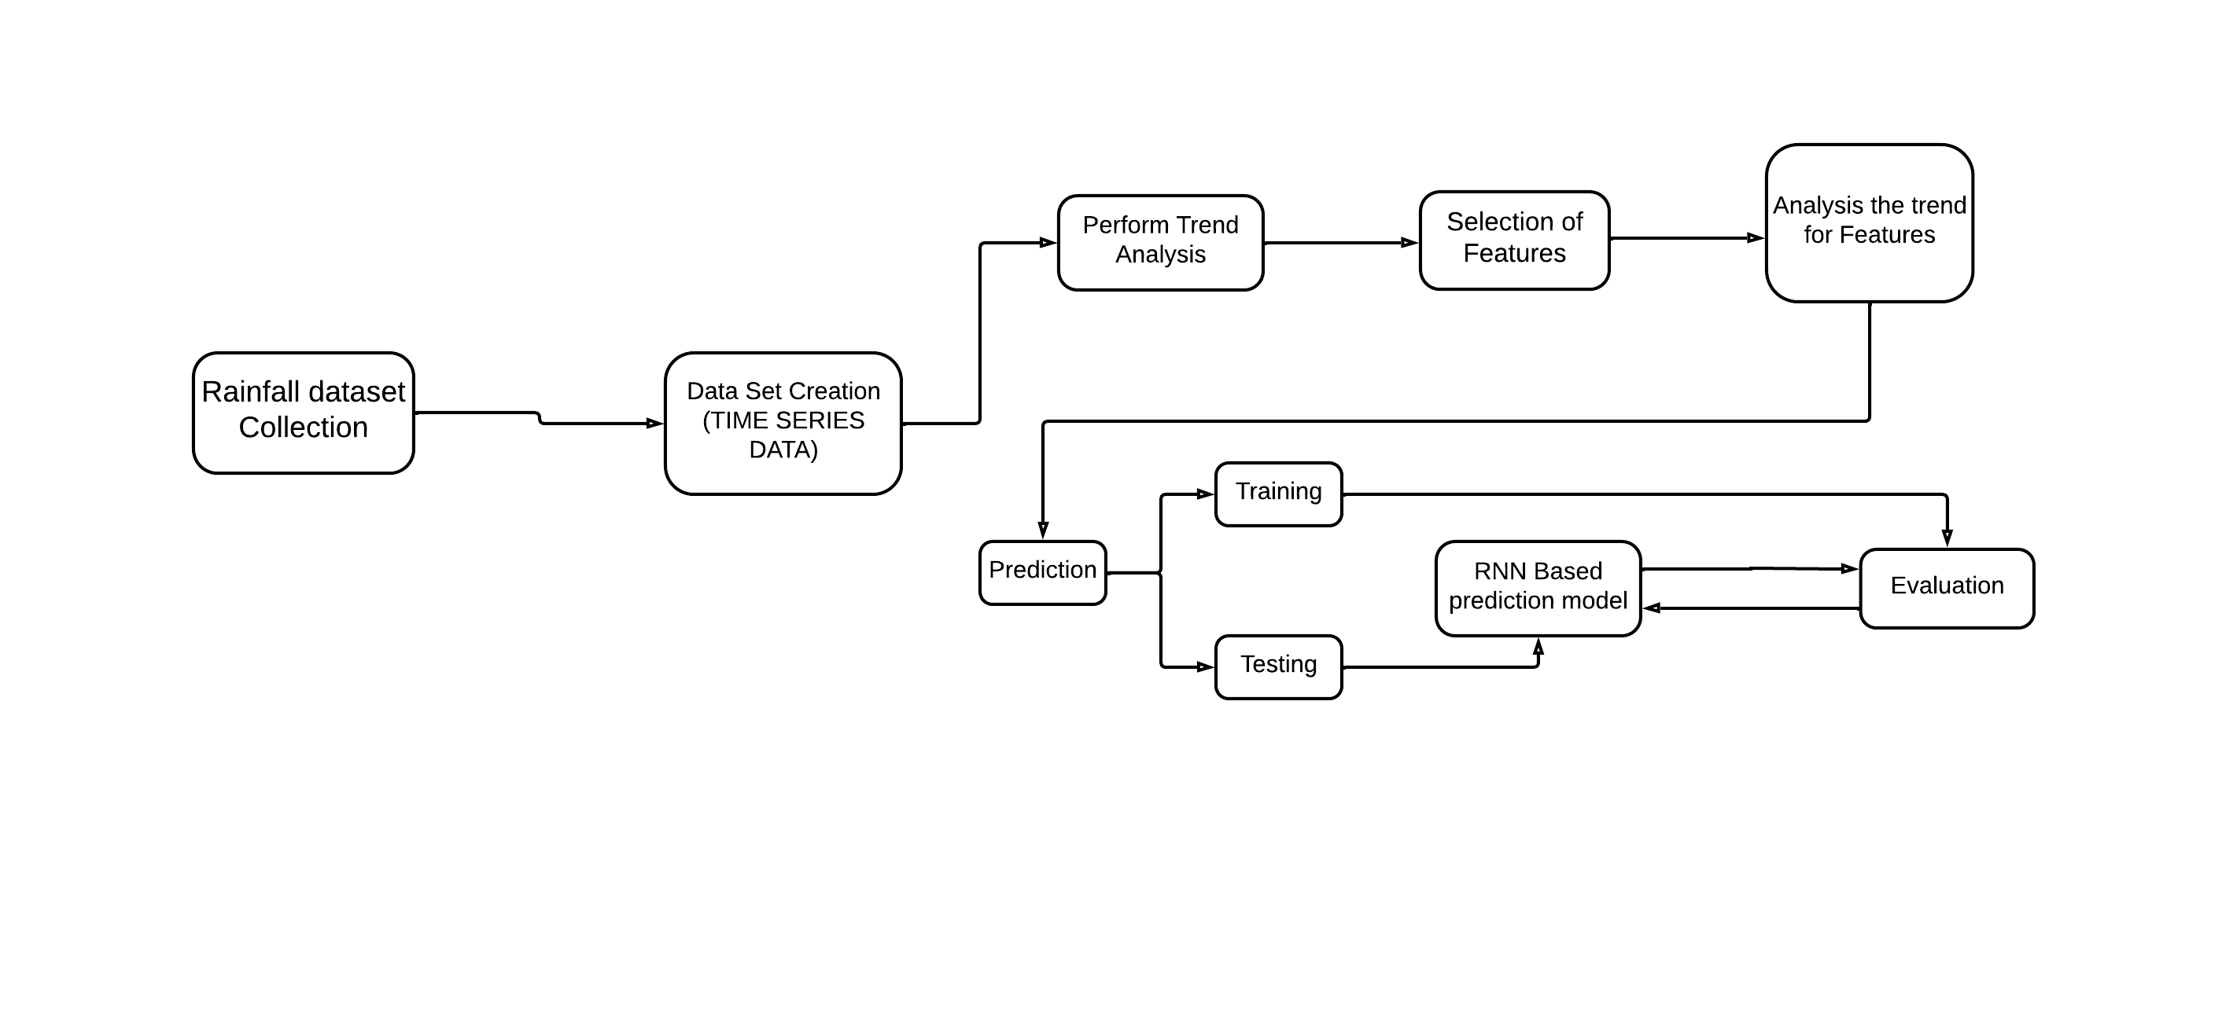
SYSTEM ARCHITECTURE
Department of CSE
Jerusalem College of Engineering

Slide 13
HARDWARE AND SOFTWARE REQUIREMENTS
SOFTWARE REQUIREMENTS:
Rainfall Dataset
R programming language
HARDWARE REQUIREMENTS:
Windows 11 (RAM-4GB)
Department of CSE
Jerusalem College of Engineering

Slide 14
PROJECT MODULES
Trend Analysis
Hypothesis Analysis
Magnitude of the trend
Prediction
Feature selection
Training
Prediction
Department of CSE
Jerusalem College of Engineering

Slide 15
INPUT DESCRIPTION
Rainfall data for 30 years (1990 – 2019) for the state of Tamil Nadu was collected from India Meteorological Department (IMD).
The data includes the seasonal rainfall in Tamil Nadu. The observations are measured in millimeters (mm). For seasonal analysis, each year is divided into four climatic seasons and the annual year data.
Hot Weather(March-May), Southwest Monsoon (June-September), Northeast Monsoon (October-December) and winter (January-February).
Department of CSE
Jerusalem College of Engineering

Slide 16
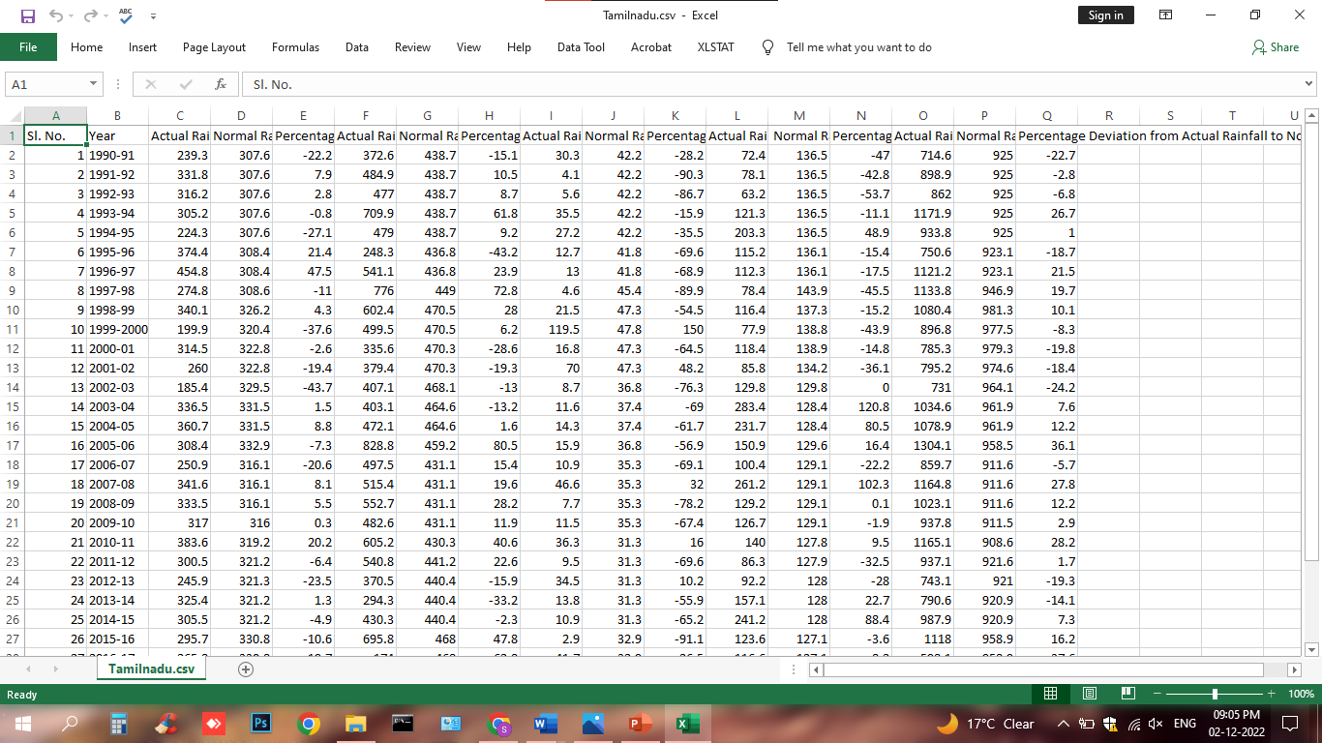
INPUT DATASET
Department of CSE
Jerusalem College of Engineering

Slide 17
MODULE DESCRIPTION
MODULE - 1
Statistically trend is a significant change over time which is detectable by parametric and non-parametric procedures. trend analysis of a time series consists of the magnitude of trend and its statistical significance.
statistical significance trend analysis was done by using Man- Kendall test while for the magnitude of trend was determined by non-parametric Sen’s estimator method.
Man-Kendall is a statistical method which is mostly used to check the null hypothesis of no trend versus the alternative hypothesis of the existence of monotonic increasing or decreasing trend of hydro-climatic time series data
Department of CSE
Jerusalem College of Engineering

Slide 18
MODULE DESCRIPTION
Module1- Hypothesis Analysis
Mann- Kendall Algorithms
The hypotheses for the test are as follows:
H0 (null hypothesis): There is no trend present in the data.
HA (alternative hypothesis): A trend is present in the data. (This could be a positive or negative trend)
Department of CSE
Jerusalem College of Engineering

Slide 19




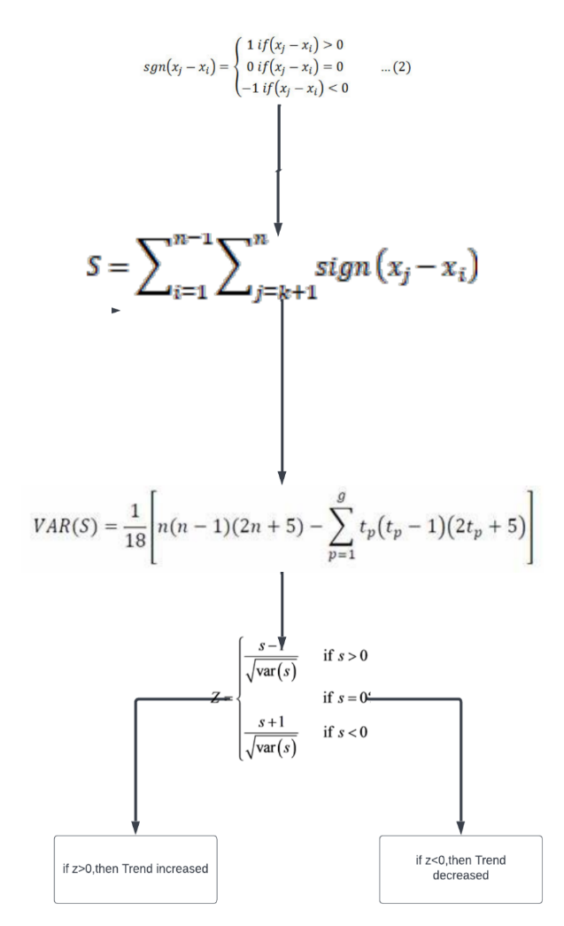
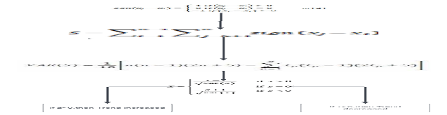
MODULE DESCRIPTION
Module-1 Mann- Kendall Algorithms
Department of CSE
Jerusalem College of Engineering

Slide 20
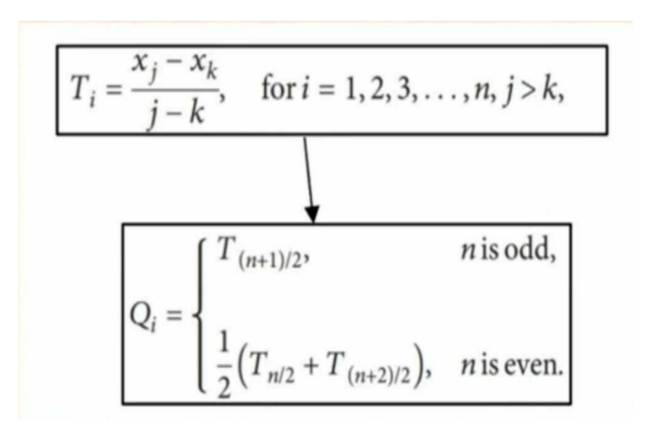
MODULE DESCRIPTION
Module1-Magnitude of the trend
Sen Slope Estimator Algorithms
Sen’s estimator is calculated using the above equation depending upon the value of n is either odd or even .
Department of CSE
Jerusalem College of Engineering

Slide 21
MODULE – 3
Module1-Magnitude of the trend
Parameter Description:
Surface Pressure(PS): The average of surface pressure at the surface of the earth
Earth Skin Temperature(TS): Earth Skin Temperature
(T2M) TEMPERATURE AT 2METER(C):The average air (dry bulb) temperature at 2 meters above the surface of the earth.
(QV2M) Specific Humidity at2 Meters: The ratio of the mass of water vapor to the total mass of air at 2 meters (kg water/kg total air
(RH2M) Relative Humidity at 2 Meters: The ratio of actual partial pressure of water vapor to the partial pressure at saturation, expressed in percent.
(WD10M)Wind Direction at 10 Meters (Degrees): The average of the wind direction at 10 meters above the surface of the earth.

Slide 22
Parameter Description
WS10M)Wind Speed at 10 Meters (m/s):The average of wind speed at 10 meters above the surface of the earth.
(T2MDEW)Dew/Frost Point at 2 Meters (C):The dew/frost point temperature at 2 meters above the surface of the earth
(GWETTOP)Surface Soil Wetness (1):The percent of soil moisture a value of 0 indicates a completely water-free soil and a value of 1 indicates a completely saturated soil; where surface is the layer from the surface 0 cm to 5 cm below grade.
(GWETPROF)Profile Soil Moisture (1):The percent of profile soil moisture a value of 0 indicates a completely water-free soil and a value of 1 indicates a completely saturated soil; where profile is the layer from the surface down to the bedrock.
(GWETROOT)Root Zone Soil Wetness 1):The percent of root zone soil wetness a value of 0 indicates a completely water-free soil and a value of 1 indicates a completely saturated soil; where root zone is the layer from the surface 0 cm to 100 cm below grade.

Slide 23
Parameter Description
(CLOUD_AMT) CERES SYN1deg Cloud Amount (%):The average percent of cloud amount during the temporal period.
(T2M _RANGE) Temperature at 2 Meters Range (C):The minimum and maximum hourly air (dry bulb) temperature range at 2 meters above the surface of the earth in the period of interest.
(WS10M_MAX) Wind speed at 10 meters maximum(m/s):The maximum hourly wind speed at 10 meters above the surface of the earth.
(WS10M MIN) Wind Speed at 10 Meters Minimum (m/s):The minimum hourly wind speed at 10 meters above the surface of the earth.
(PRECTOTCORR) Precipitation Corrected (mm/day):The bias corrected average of total precipitation at the surface of the earth in water mass (includes water content in snow).
(WS10M_RANGE) Wind Speed at 10 Meters Range (m/s):The minimum and maximum hourly wind speed range at 10 meters above the surface of the earth.
(PRECTOTCORR _SUM) Precipitation Corrected Sum (mm): The bias corrected sum of total precipitation at the surface of the earth.

Slide 24
Feature selection
Pearson Correlation Coefficient:
Pearson correlation coefficient also referred to as Pearson’s r or the bivariate correlation is a statistic that measures the linear correlation between two variables X and Y.
It has a value between +1 and −1. A value of +1 is a total positive linear correlation, 0 is no linear correlation, and −1 is a total negative linear correlation.
A relationship is linear only when a change in one variable is associated with a proportional change in the other variable

Slide 25
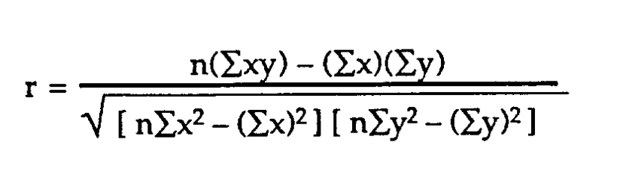
the Pearson's correlation coefficient (r)-it describes the strength and direction of the linear relationship between two quantitative variables.
The Pearson correlation coefficient is also an inferential statistic,meaning that it can be used to test statistical hypotheses. Specifically, we can test whether there is a significant relationship between two variables.

Slide 26
Module 4-Prediction Model
LSTM is a type of architecture explicitly designed to avoid the long-term dependency problem.
The LSTMs network can learn what to store and what to throw away by in splitting the memory, it has two states: the short-term state, represented by the vector h (t), and the long-term state, represented by the C (t) vector.
LSTM can remove or add information to the cell state, regulated by three gates:
Forget gate: decides what information will be deleted from the cell state by applying a sigmoid over the previously hidden state h (t−1) and the input x (t).
Input gate: decides what new information will be stored in the cell state
Output gate: decides the final output by running a sigmoid on the hidden state and the input

Slide 27
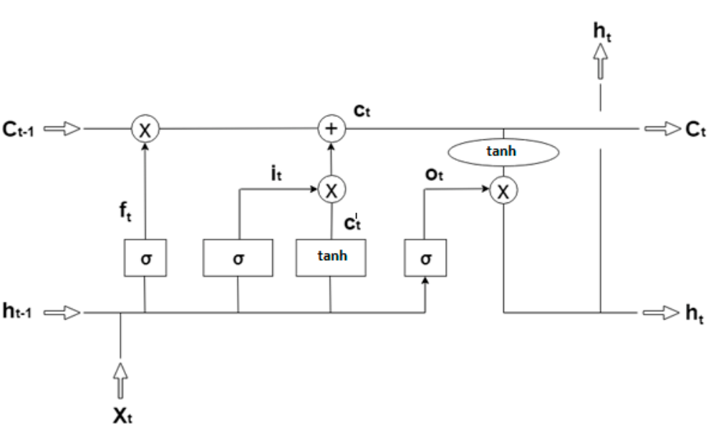
Prediction Model
Architecture of prediction Model:

Slide 28
IMPLEMENTATION
Name | Max | Min | Mean | Std div | Z | Q
Actual Rainfall in South-West Monsoon (in mm) | 454.800 | 185.400 | 312.043 | 62.960 | 0.7850 | 1.1611
Actual Rainfall in North-East Monsoon (in mm) | 828.800 | 174.000 | 485.052 | 144.564 | -0.3925 | -0.4583
Actual Rainfall in Winter Season(in mm) | 119.500 | 2.900 | 23.336 | 23.671 | 0.0356 | 0.01
Actual Rainfall in Hot Weather Period (in mm) | 283.400 | 63.200 | 132.273 | 57.588 | 1.8022 | 1.275
Actual Rainfall in Whole Year (in mm) | 1304.100 | 598.100 | 952.713 | 168.131 | 0.1784 | 1.21
Department of CSE
Jerusalem College of Engineering

Slide 29
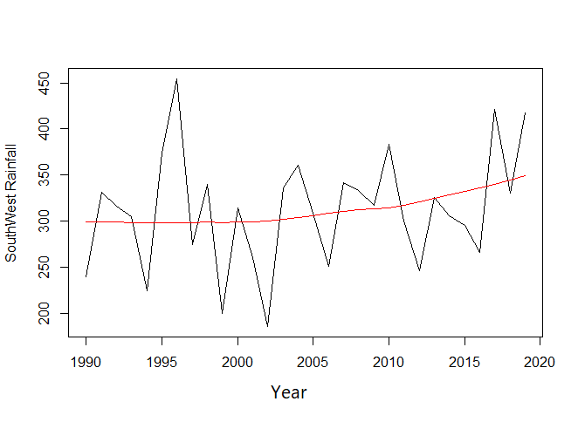
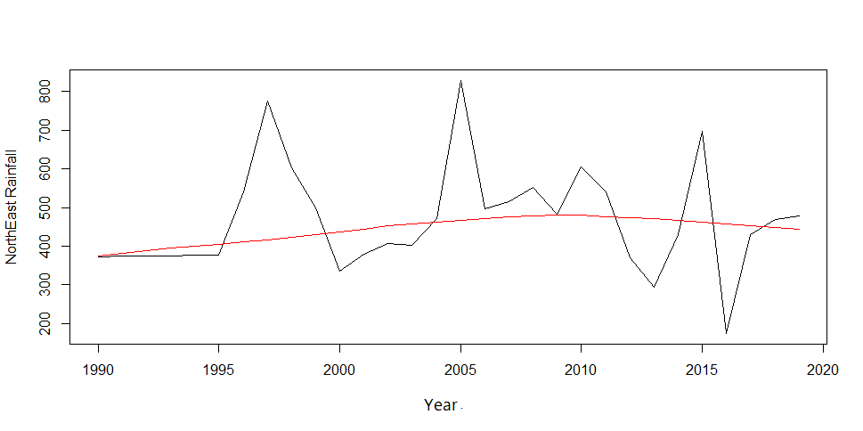
IMPLEMENTATION
The southwest season shows an increasing trend with Z and Q values 0.7850 and 1.1611
The NorthEast season shows an decreasing trend with Z and Q values -0.3925 and -0.4583
Department of CSE
Jerusalem College of Engineering

Slide 30
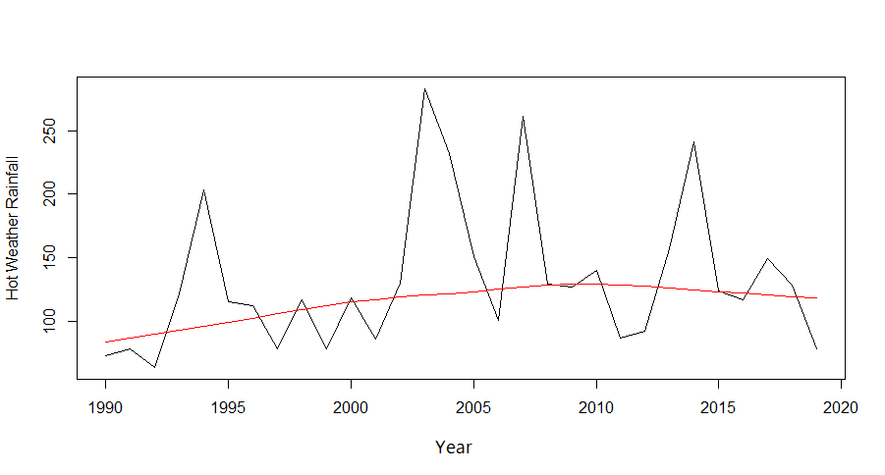
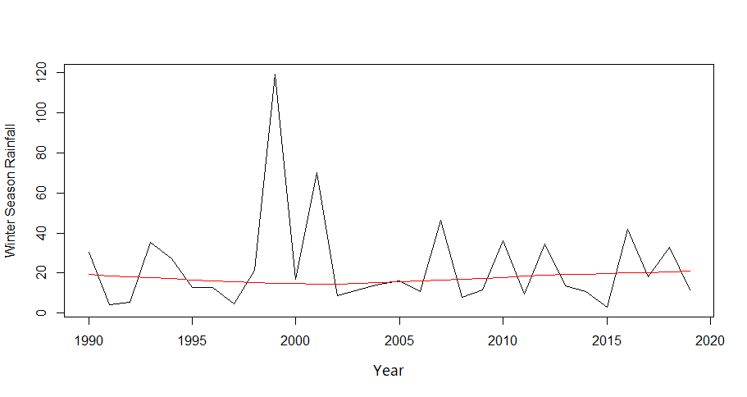
IMPLEMENTATION
The Hot weather season shows an increasing trend with Z and Q values of 1.8022 and 1.275
The Winter season shows a increasing trend with Z and Q values of 0.0356 and 0.01
Department of CSE
Jerusalem College of Engineering

Slide 31
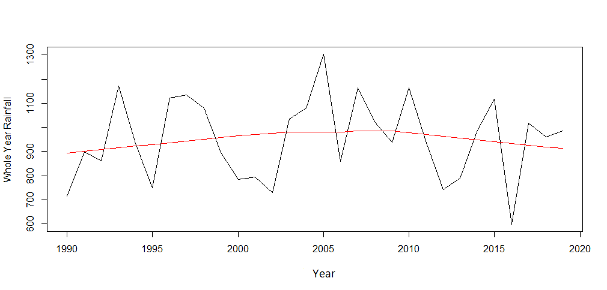
IMPLEMENTATION
The rainfall in whole year shows an increasing trend with Z and Q values of 0.1784
And 1.21
Department of CSE
Jerusalem College of Engineering

Slide 32
CONCLUSION
The seasonal-wise trend of rainfall volume, in many cases, is not the same as observed for the previous region.
The northeast monsoon shows a decreasing trend while other seasons show an increasing trend.
The decreasing trend of North-East rainfall, can cause a drought situation and hamper agricultural activities like land preparation, particularly in non-irrigated areas.
Department of CSE
Jerusalem College of Engineering

Slide 33
FUTURE WORK
The trend is analyzed in detail by considering the various features such as temperature and humidity for the region.
The analyzed trend gives the reason for the increased or decreased trend of rainfall.
A further prediction of rainfall is done using the neural network with LSTM can hold a large number of previous datasets, thereby overcoming the vanishing gradient, which leads to better accuracy in the prediction.
Department of CSE
Jerusalem College of Engineering

Slide 34
REFERENCES
[1] Lince Rachel Varghese A Time-series based Prediction Analysis of Rainfall Detection(2020)
[2] Shyam Lochan Bora,,Kalyan Bhuyan, Partha Jyoti Hazarika3, Junmi Gogoi andKuldeep Goswami: Analysis of rainfall trend using non-parametric methods andinnovative trend analysis during 1901–2020 in seven states of North East India(2022)
[3] Fiaz Hussain, Ghulam Nabi, Muhammad Waseem Boota Rainfall Trend Analysisby Using the Mann-Kendall test & Sen's Slope Estimates : A Case Study of District Chawal Rain Gauge,Barani area, Northern Punjab Province for Pakistan.(2015)
[4] Rawshan Ali, Alban Kuriqi , Shadan Abubaker and Ozgur Kisi Long-TermTrendsand Seasonality Detection of the Observed Flow in Yangtze River Using Mann- Kendall and Sen’s Innovative Trend Method (2019)
[5] Salma, S., S. Rehman, M. A. Shah Rainfall Trends in Different Climate Zones of Pakistan.(2012)
Department of CSE
Jerusalem College of Engineering

